Slide 1
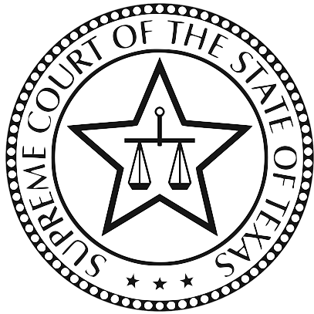
Supreme Court of Texas Update
Tyler Talbert
September 26, 2019
Bell County, Texas

Slide 2
Takeaways from SCOTX ‘18-’19
Hot topics
Significant holdings
Themes
What to watch out for
Takeaways

Slide 3
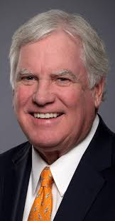
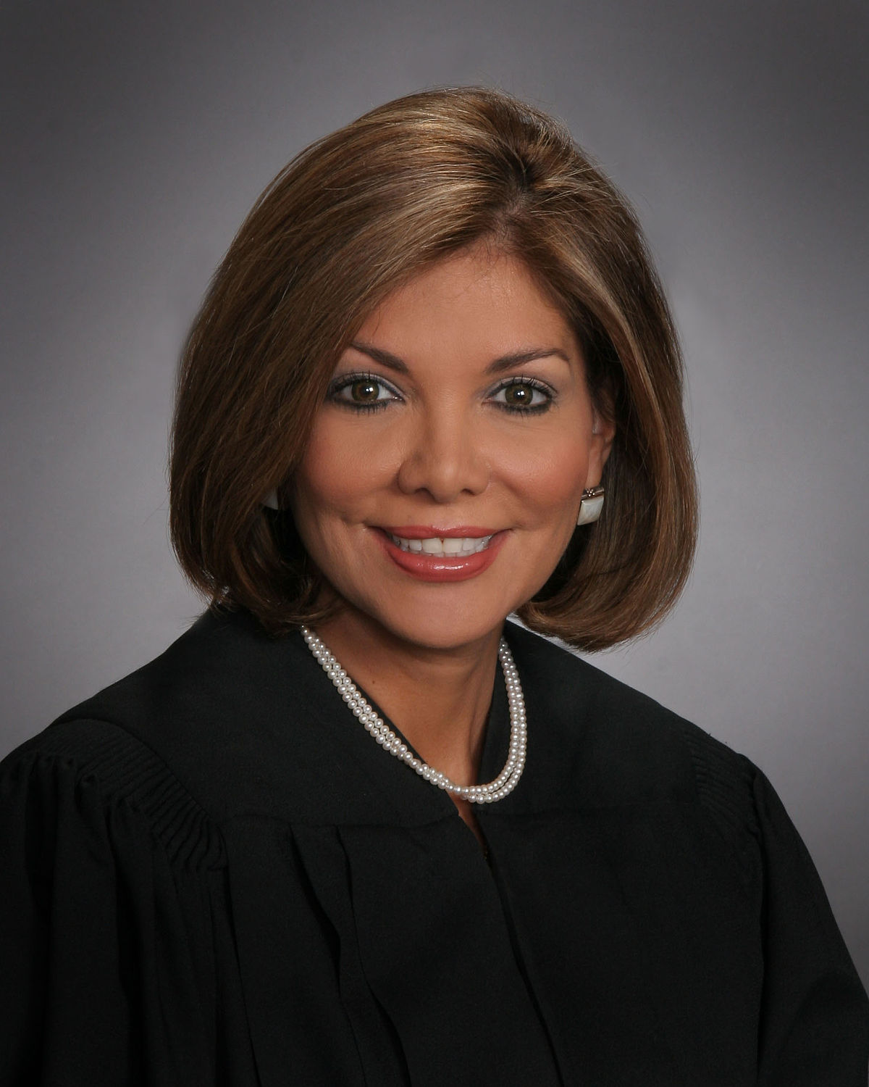
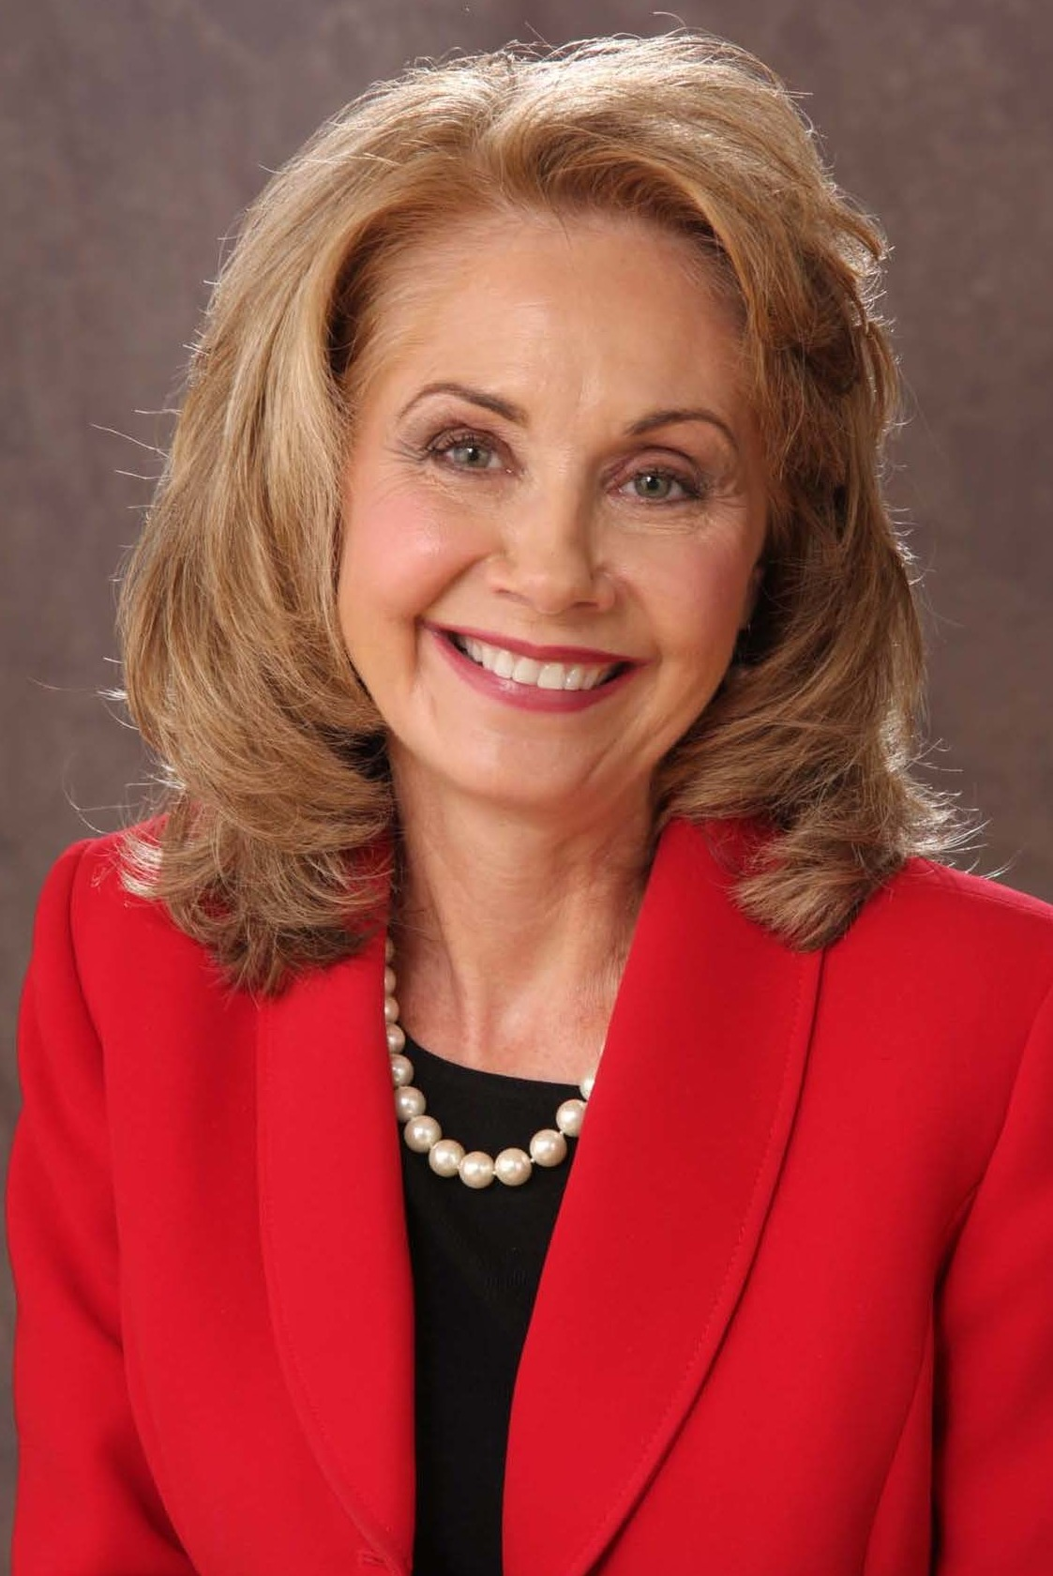
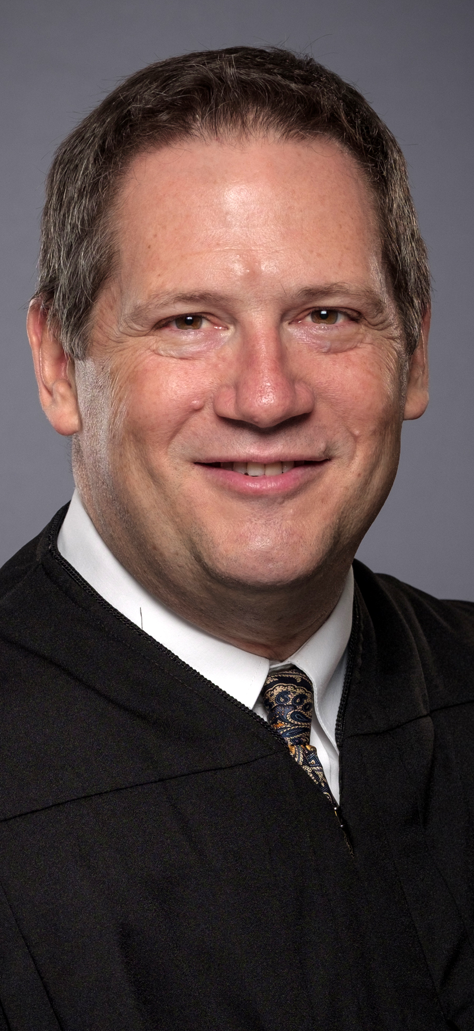
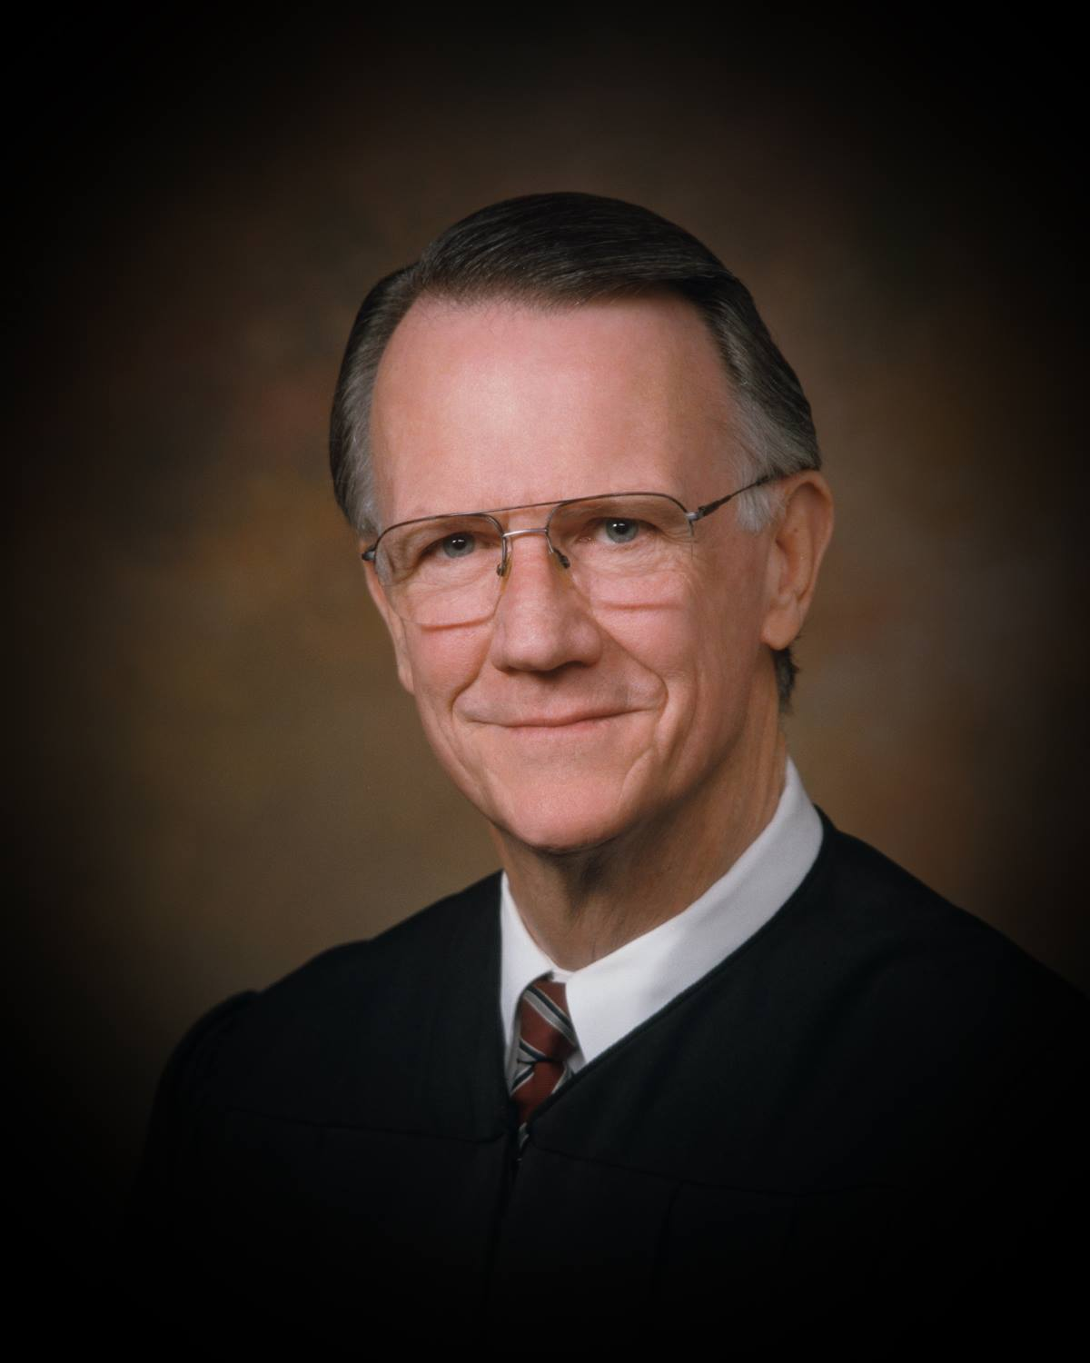
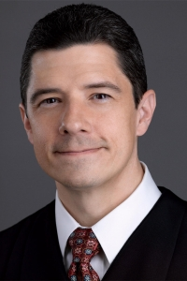
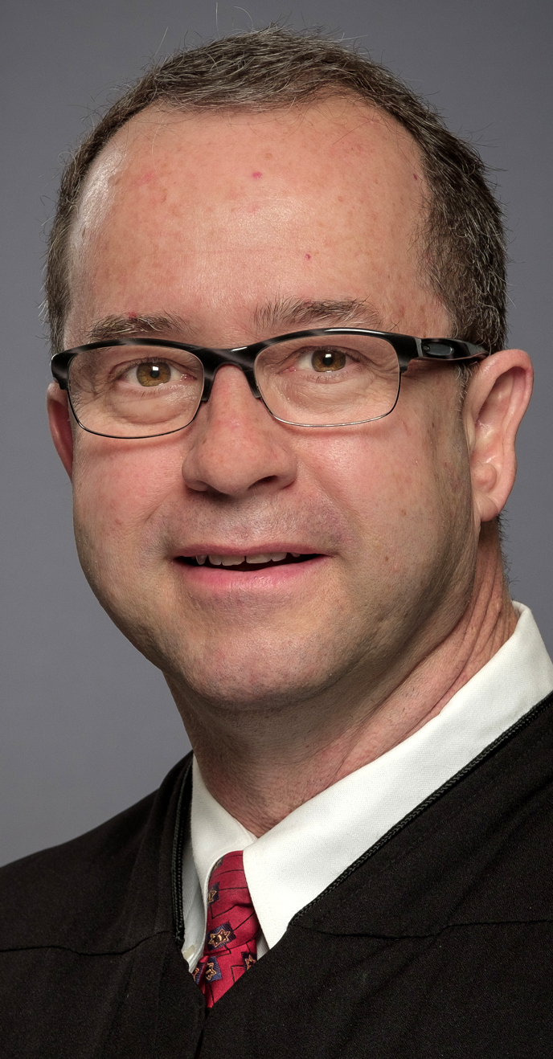
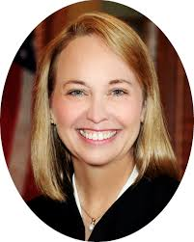
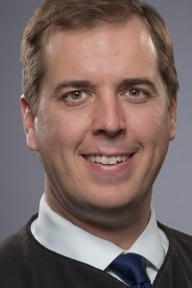
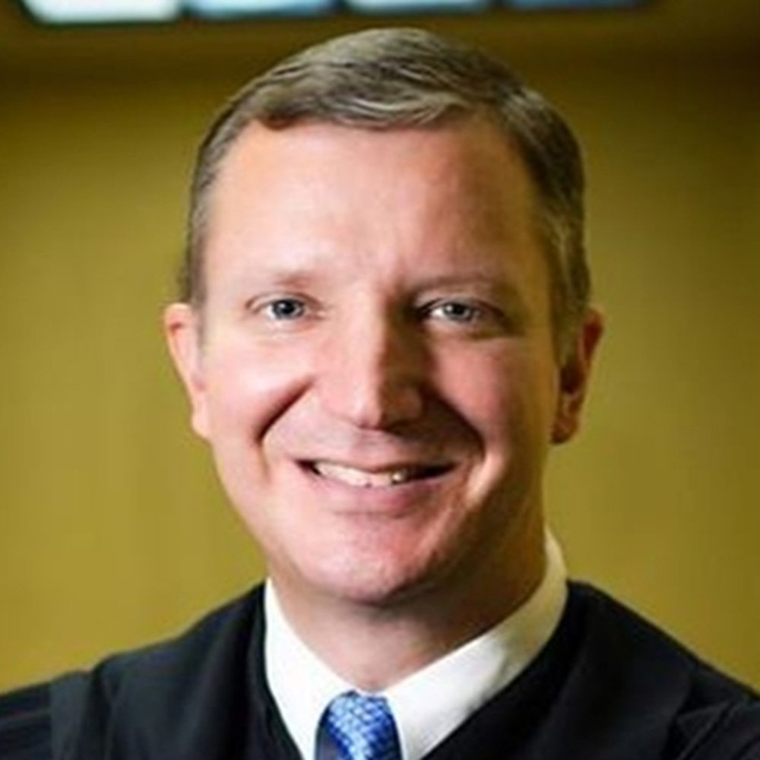
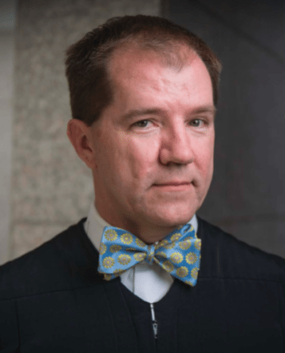
10. The times they are a changin’
Chief Justice Nathan L. Hecht
Justice Eva Guzman
Justice Paul Green
Justice Debra Lehrmann
Justice Jeff Boyd
Justice Brett Busby
Justice Phil Johnson
Justice Jane Bland
Justice Jeff Brown
Justice Jimmy Blacklock
Justice Don Willett
Justice John Devine

Slide 4
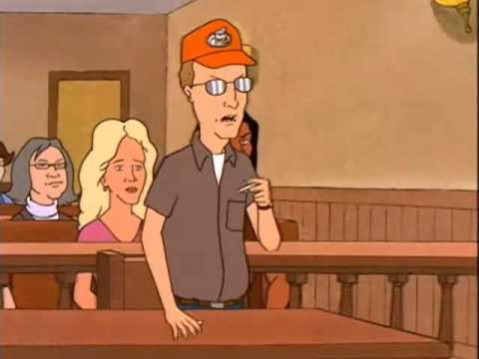
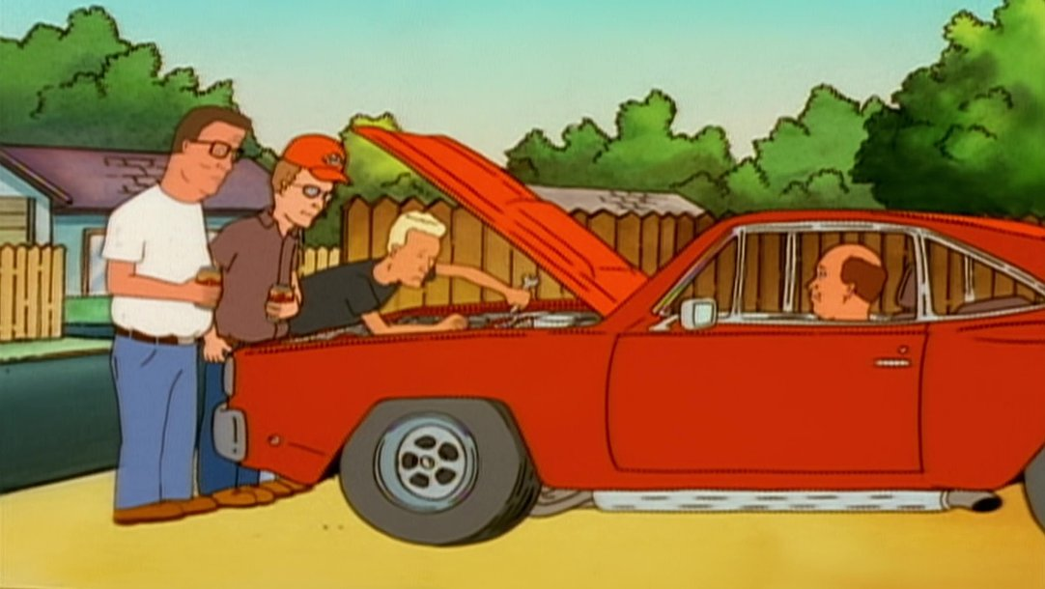
9. How long, how long?
Civil Conspiracy
Civil Conspiracy is a derivative claim that takes the limitations period and accrual rule of the underlying tort.
Agar Corp. v. Electro Circuits Int’l, LLC
Implied Warranty Good and Workmanlike Repair
Warranty claim not brought under the DTPA is not barred by the two-year limitations period. Obligation arises by contract, four years.
Nghiem v. Sajib

Slide 5
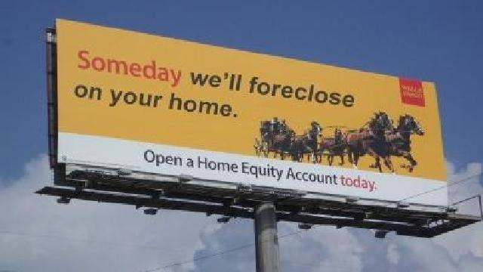
Godoy v. Wells Fargo Bank, N.A.
9... a little longer?
Waiver of Statute of Limitations
Contractual waivers of statute of limitations must be sufficiently specific and for a reasonable time to not be void as against public policy.
Limitations waivers are enforceable, though not impenetrable.
Rule 94 “public policy” pleading not required.
GUARANTOR’S WAIVERS.
Guarantor also waives any and all rights or defenses arising by reason of:
(A) any “one action” or “anti-deficiency” law or any other law which may prevent Lender from bringing any action, including a claim for deficiency, against Guarantor, before or after Lender’s commencement or completion of any foreclosure action, either judicially or by exercise of a power of sale

Slide 6
8. Too late to probate
Ferreira v. Butler
Time to Probate a Will
§256.003 grants a four-year window to probate a will, or longer if the applicant “was not in default”
The four-year period to probate a will binds those who stand in the shoes of the defaulting party.
But a party could probate a will after the four-year period in an individual capacity.
Future implications?

Slide 7
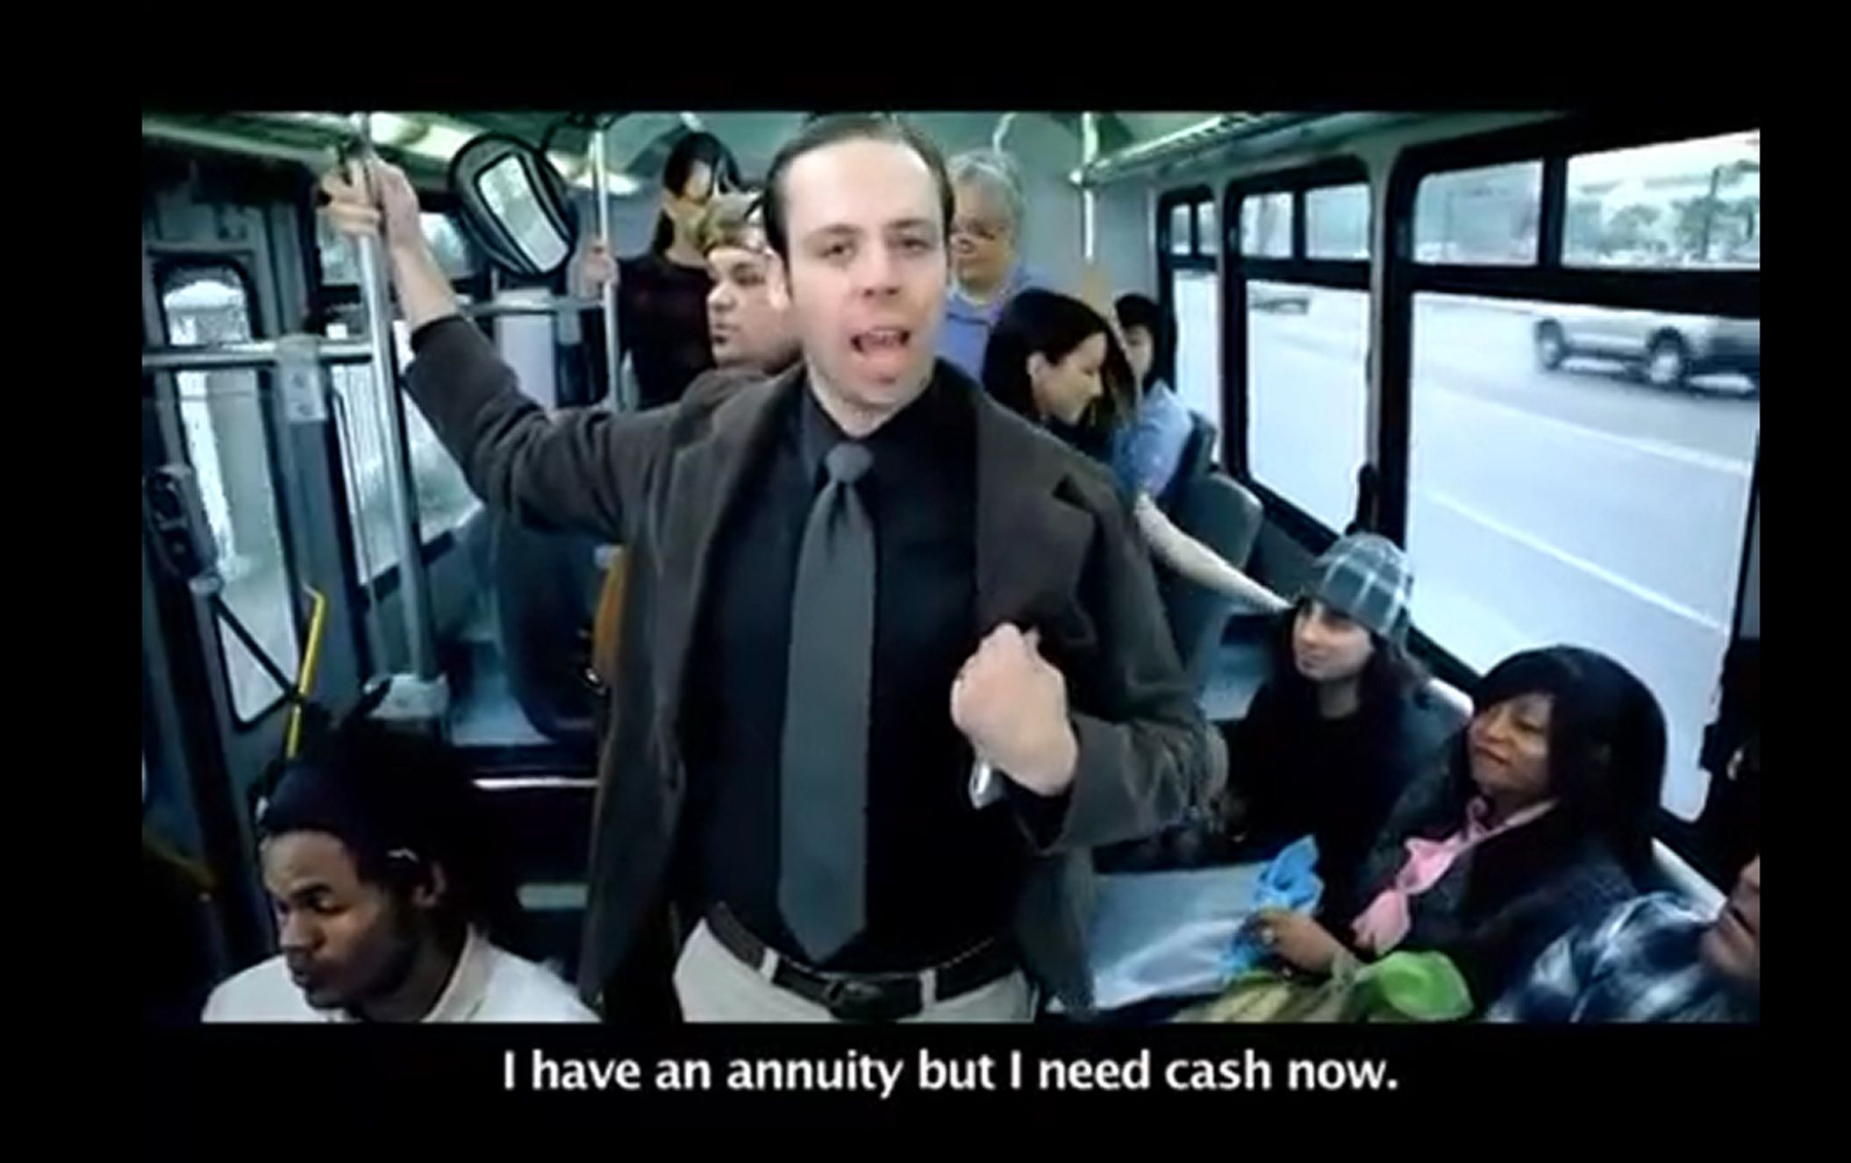
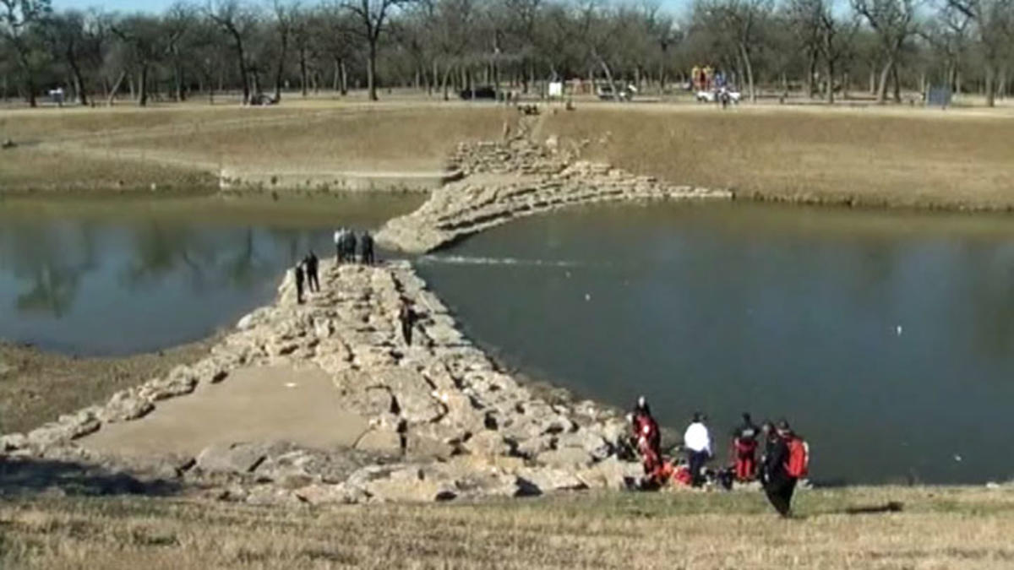
7. The usual suspects
Governmental Immunity
Worsdale, PHI, Tom Green
Arbitration Agreements
RSL Funding
Jury Charge
Musallam v. Ali
Chapter 74 Reports
BSW v. Weems
TCPA
Dallas Morning News

Slide 8
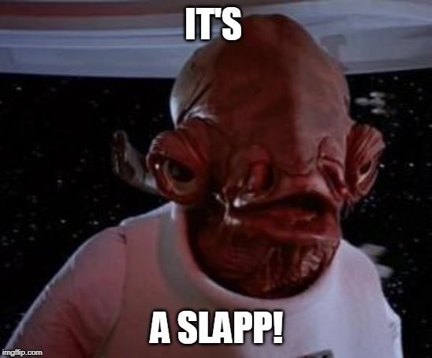
Dallas Morning News v. Hall
6. It’s a SLAPP!
TCPA
“The TCPA protects citizens who [associate,] petition or speak on matters of public concern from retaliatory lawsuits that seek to intimidate or silence them.”
Application:
Employment disputes, non-compete, fraud, trade secret, hospital lien, appellate court, 202 Petitions, Attorney misconduct, TCPA Motions.
One-way fee shifter; interlocutory appeal.
Changes – September 1.

Slide 9
5. Fees please
Attorney’s Fees
Billing records strongly encouraged
Sufficient evidence includes, at a minimum
(1) particular services,
(2) who,
(3) when,
(4) the reasonable amount of time, and
(5) the reasonable hourly rate.
Changes? Records, Cross, Experts, Stipulations
Rohrmoos Venture v. UTSW DVA Healthcare, LLP

Slide 10
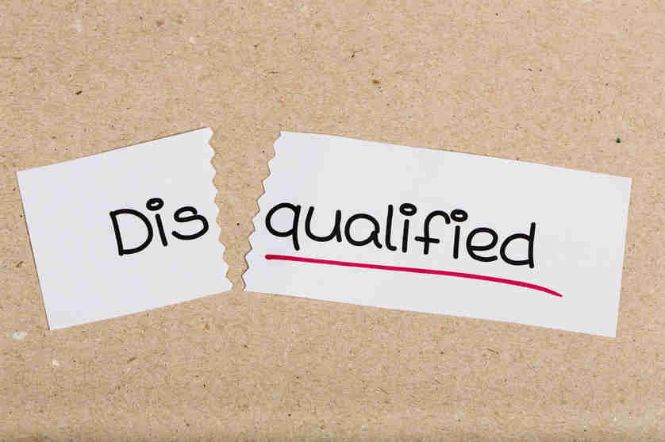
In re Thetford
4. I thought you were my lawyer!
Guardianships & Disqualification
Attorney was not disqualified from representing one client who is applying for guardianship for one of the lawyer’s former or current clients.
Fact-specific.
(1) Substantially related; (2) adverse.
Dissent
ABA model rules prohibit a lawyer from representing third-party seeking to impose a guardianship on the lawyer’s client.

Slide 11
In re City of Dickinson
3. How (not) to screw up discovery
Privileged Documents
Providing documents to employee/expert witness, does not forfeit the attorney-client privilege as to those documents.
192.3(e) expert discovery does not overcome privilege
Snap-Back Motions
193.3(d) allows a party that has inadvertently produced documents to preserve privilege and “snap back” the documents.

Slide 12
West v. Quintanilla & Barrow-Shaver v. Carrizo Oil & Gas,
2. The contracts speaks for itself?
Parol Evidence
The parol evidence rule does not bar an agreement that is “collateral” to and not inconsistent with a prior agreement. (Quintanilla).
Evidence of prior drafts could not overcome plain language of the contract. (Barrow Shaver)
Industry Custom?
Prior Negotiations?

Slide 13
Mercedes-Benz v. Carduco & IBM v. Lukin
1. RIP Fraudulent Inducement?
Fraudulent Inducement
Contract terms can bar fraud theories.
“The parties’ written agreement directly contradicts plaintiff’s alleged belief and thereby negates its justifiable reliance as a matter of law.” (Mercedes)
“. . . cannot maintain a claim that it reasonably relied on any earlier misrepresentations when it disclaimed reliance on such misrepresentations.” (IBM)

Slide 14
SCOTX ‘19-’20
Ebola & Wedding Dress Shopping
Chapter 74 Reports
Coming Attractions Bridal & Formal, Inc. v. Tex. Health Res.
Lottery Mishap!
Governmental Immunity
GTECH Corp. v. Steele
Widow’s Benefits
Course/scope employment
Orozco v. County of El Paso
(More) TCPA!
Public concern
Creative Oil v. Lona Hills Ranch, LLC
Replyer beware!
Email contracts
Copano Energy, LLC v. Stanley D. Bujnoch, Life Estate,

Slide 15
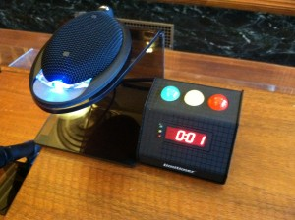
Red light!
10. Court composition
9. Statute of Limitations
8. Will Contests
7. Hot Topics
6. TCPA
5. Attorney’s Fees
4. Attorney Disqualification
3. Privilege, Experts
2. Contract Interpretation
1. Fraudulent Inducement
Resources
SCOTXBlog
www.scotxblog.com/
Texas Appellate Watch
texasappellatewatch.typepad.com
TAMES
search.txcourts.gov/
talbert@scanesrouth.com

